Slide 1
Supervised Learning

Slide 2
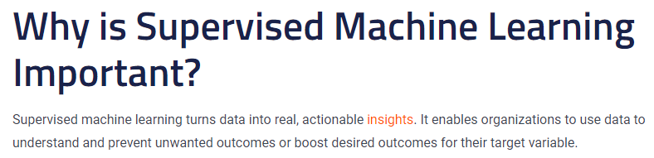

Slide 3
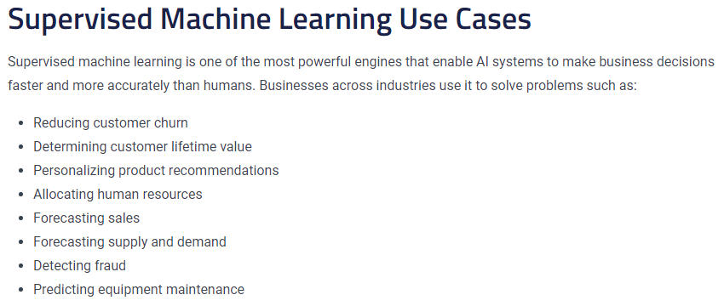

Slide 4
Supervised Machine Learning
Supervised machine learning algorithms uncover insights, patterns, and relationships from a labeled training dataset.
(i.e.) Supervised learning is applied when the data is in the form of input variables and output target values. The algorithm learns the mapping function from the input to the output. These approaches can be broadly divided into two main categories:
Classification
Regression

Slide 5
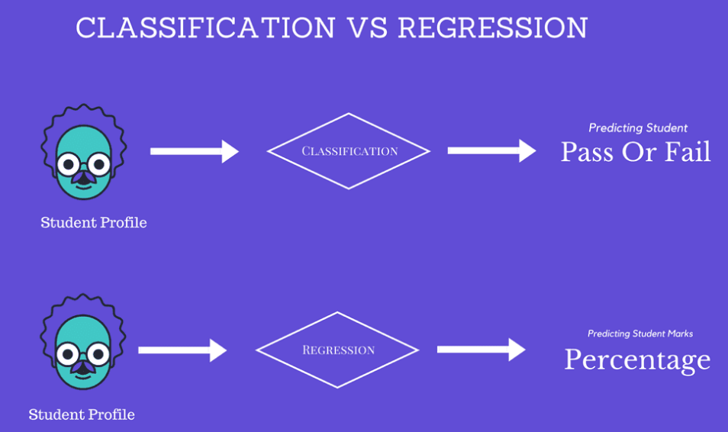
Classification:
The output variable is one of some known number of categories. For example, ”cat” or ”dog”, ”positive” or ”negative”.
Regression:
The output variable is a real or a continuous value. For example, ”price”, ”Weather”, ”geographical location”.

Slide 6
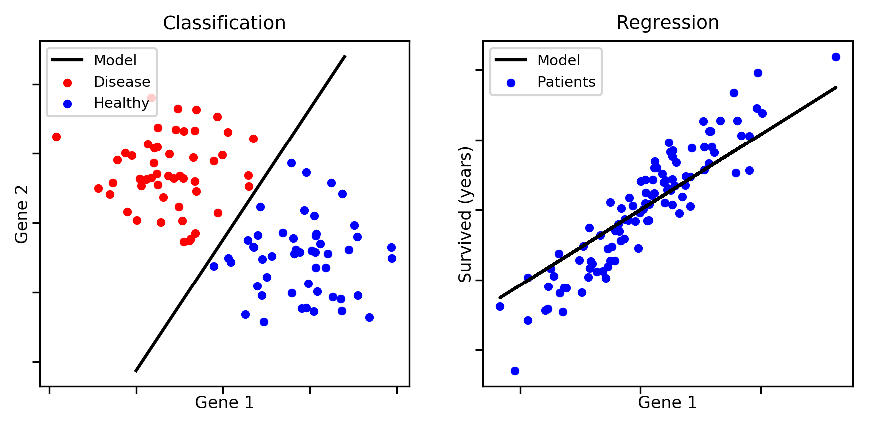

Slide 7
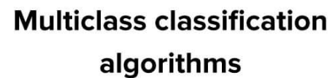
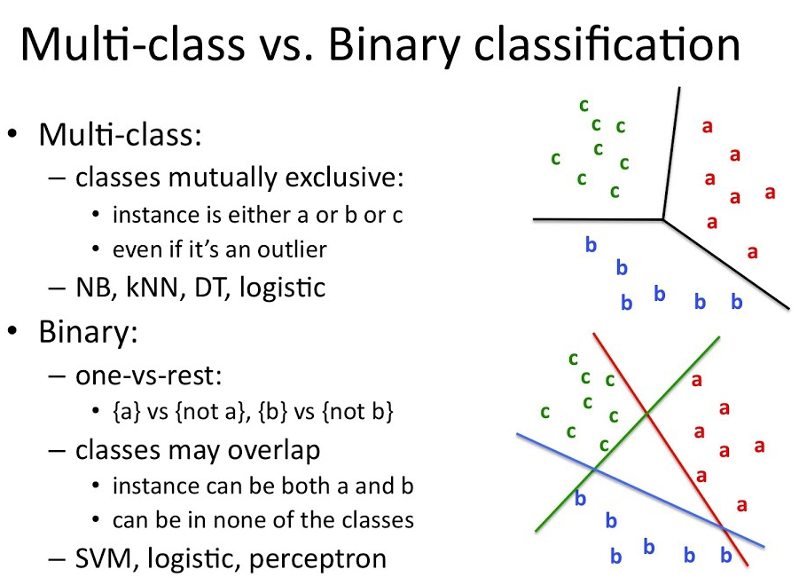
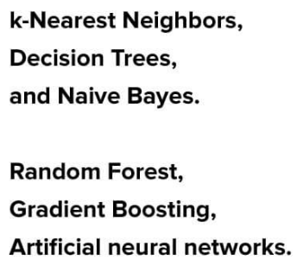

Slide 8
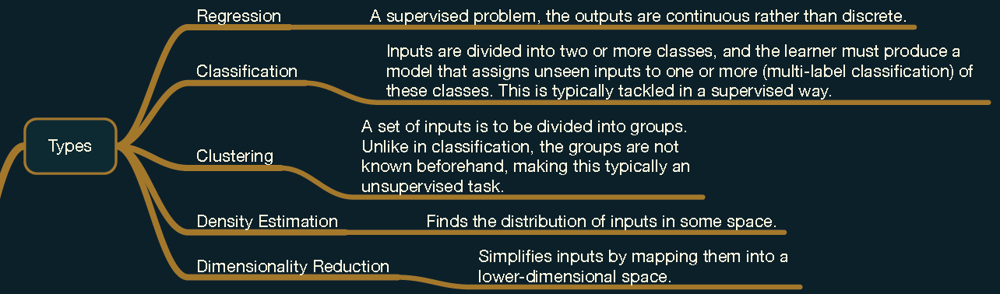

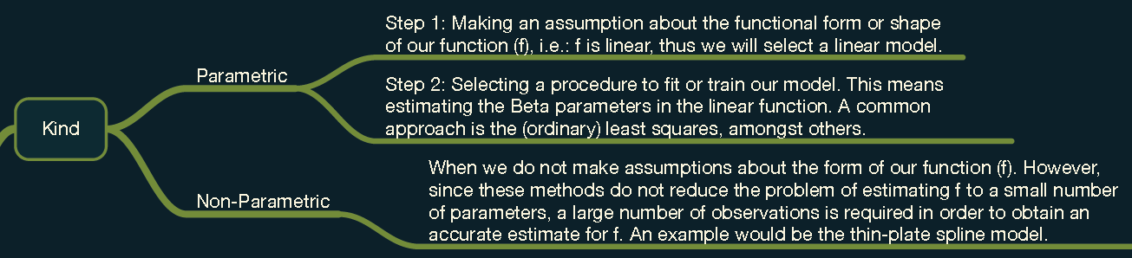

Slide 9
Linear
Ridge
Lasso
Logistic
Regression
Bayesian
Naive Bayes
Dimensionality Reduction
Principal Component Analysis (PCA)
Instance Based
k-nearest Neighbour (kNN)
Machine Learning
Models
Decision Tree
Random Forest
Clustering
Hierarchical Clustering
k-Means
Algorithms
Neural Networks

Slide 10
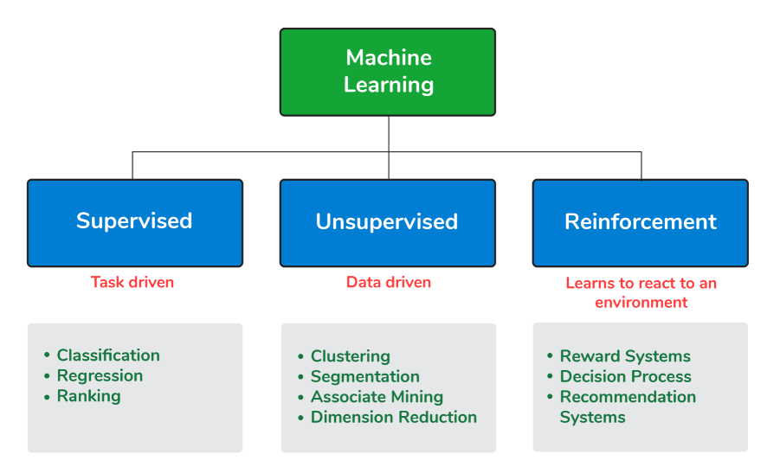

Slide 11
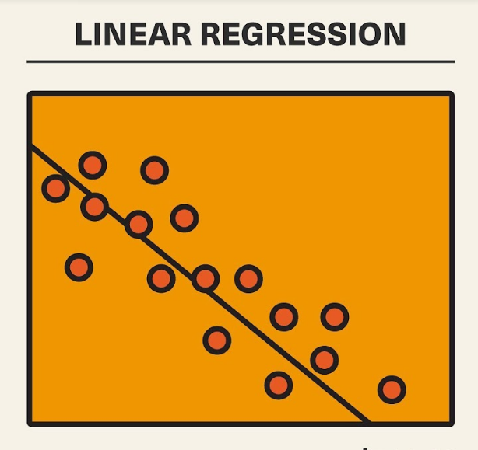
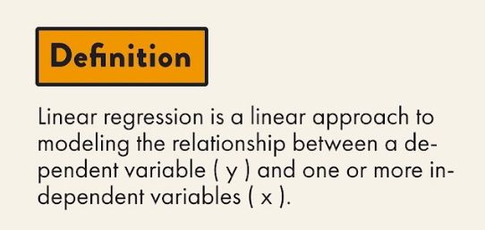

Slide 12
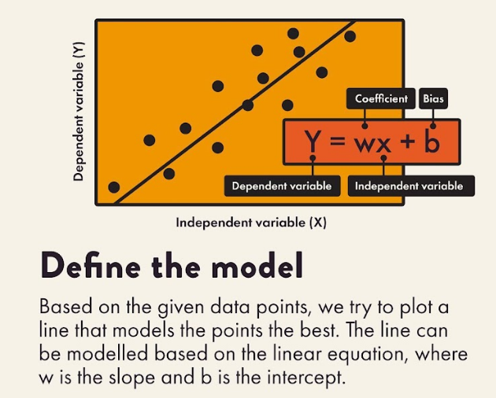
Linear Regression

Slide 13
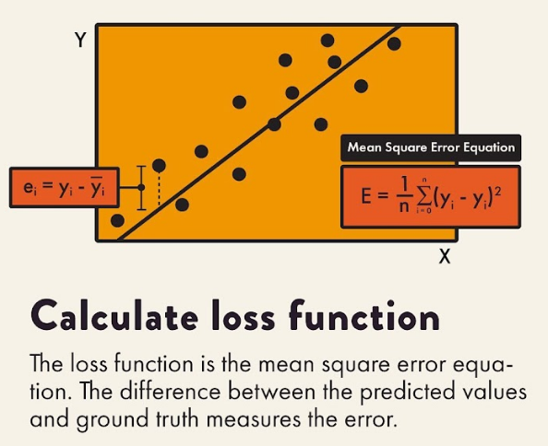
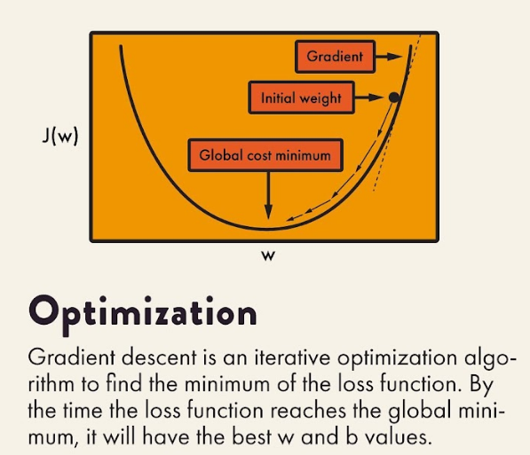
Linear Regression

Slide 14
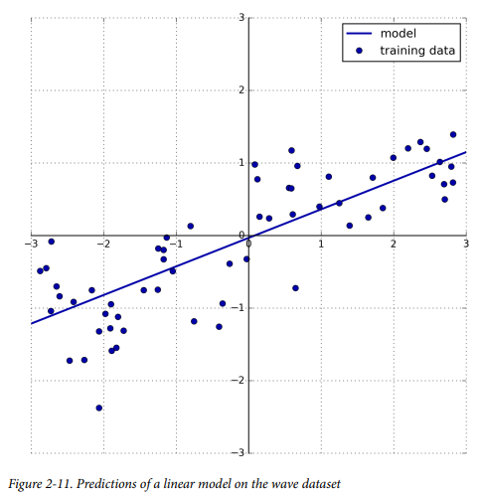
ordinary least squares (OLS)
Linear regression finds the parameters ‘w’ and ‘b’ that minimize the mean squared error between predictions and the true regression targets ‘y’ on the training set. The mean squared error is the sum of the squared differences between the predictions and the true values.

Slide 15
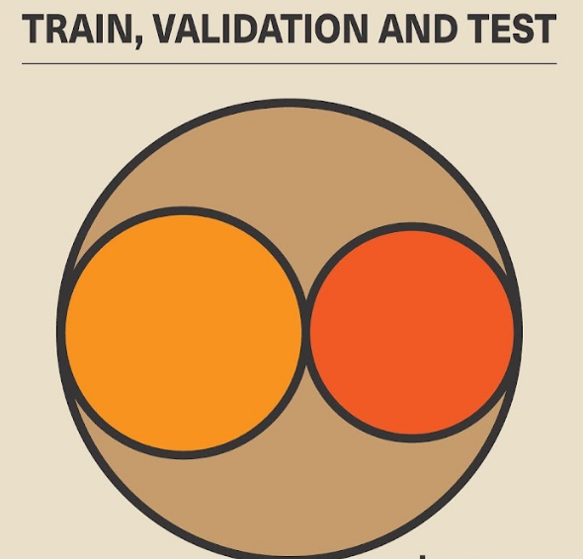
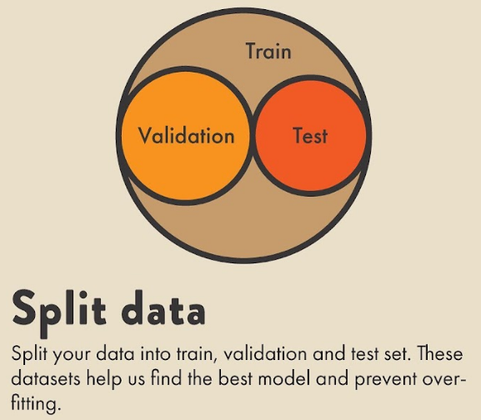

Slide 16
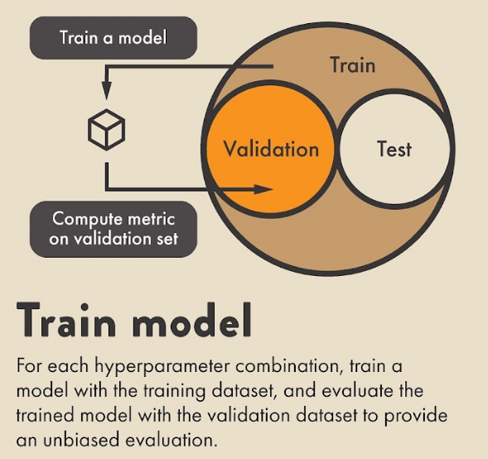
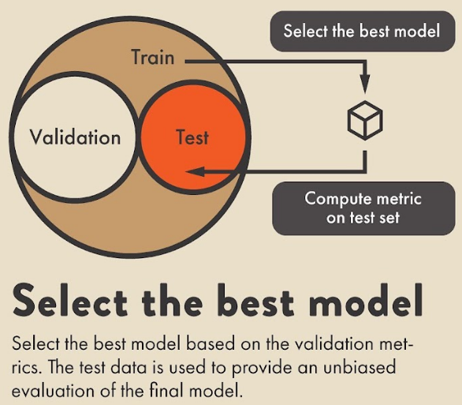

Slide 18
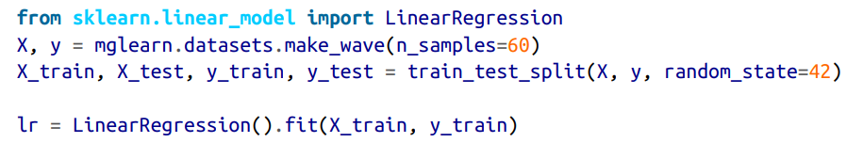

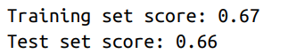
Linear Regression

Slide 19
Multiple linear regression
Multiple linear regression is a regression model that estimates the relationship between a quantitative dependent variable and two or more independent variables using a straight line.

Slide 20

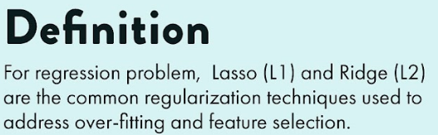
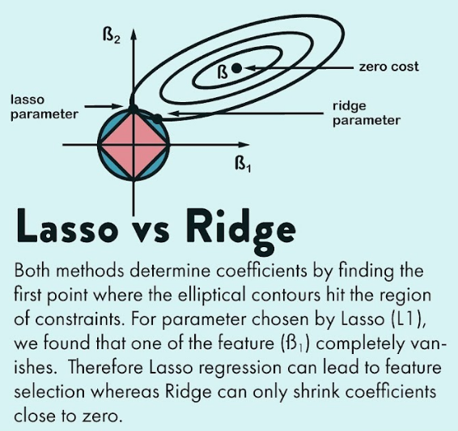
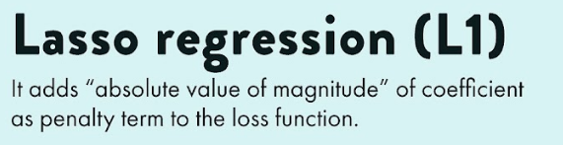
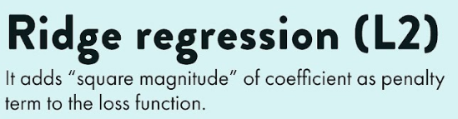

Slide 21
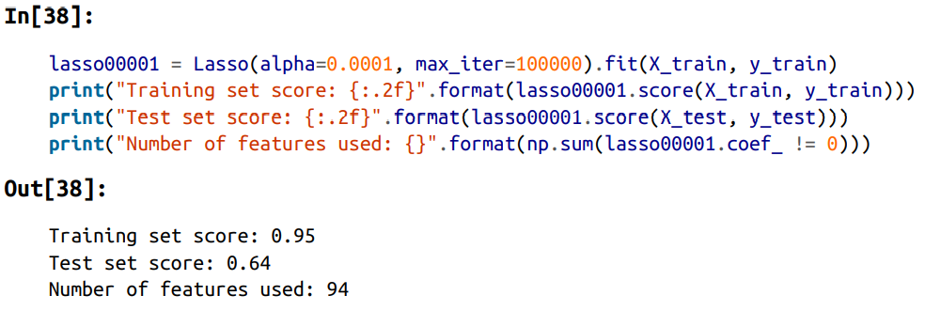
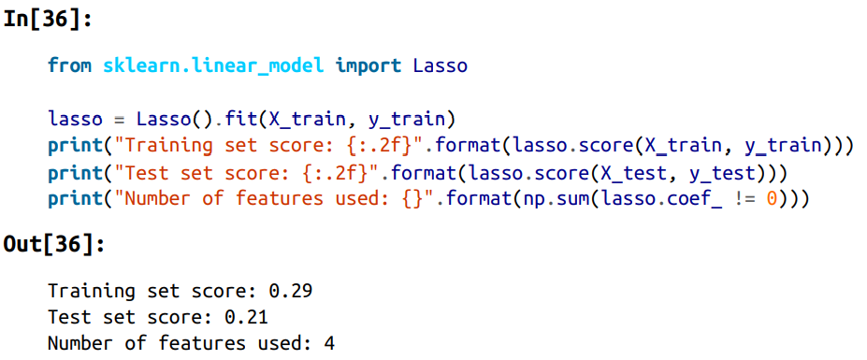
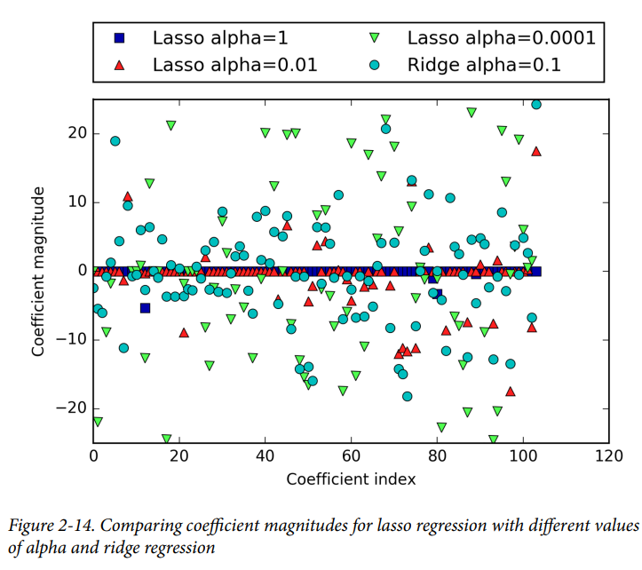
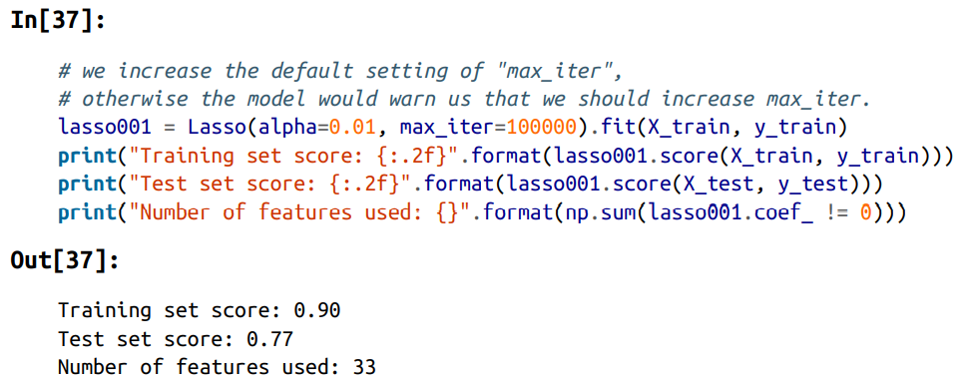
Least Absolute Shrinkage and Selection Operator

Slide 22
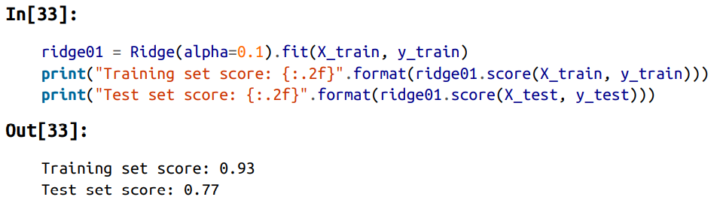
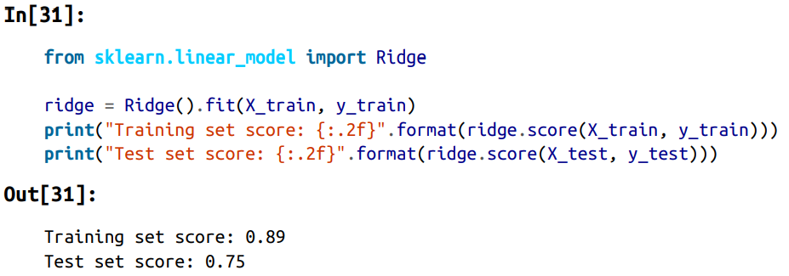
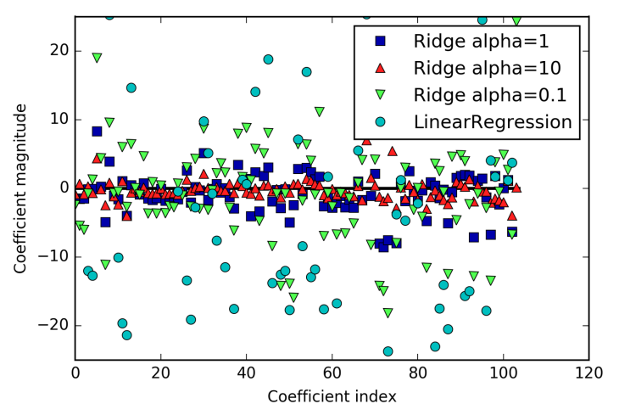
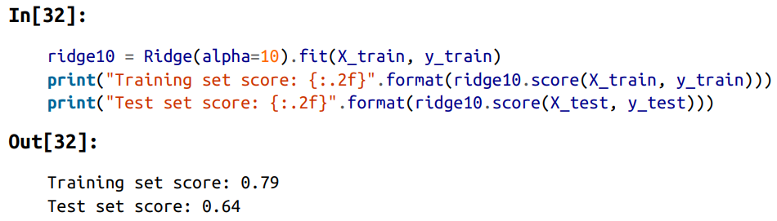

Slide 23
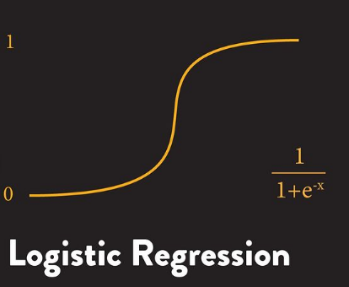
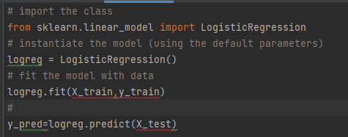
Logistic regression is a statistical method for predicting binary classes. The outcome or target variable is dichotomous in nature. Dichotomous means there are only two possible classes. For example, it can be used for cancer detection problems. It computes the probability of an event occurrence.

Slide 24
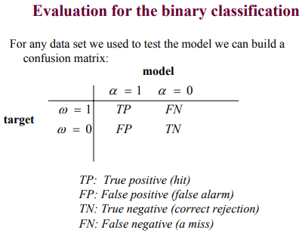
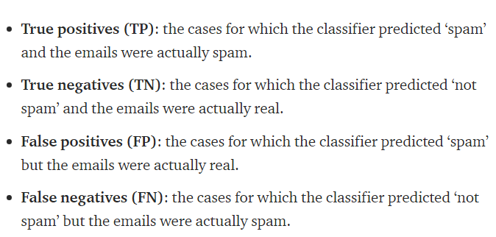

Slide 25
Difference between Classification and Linear Regression?
1. Fundamentally, classification is about predicting a label and regression is about predicting a quantity.
i.e. Classification is the task of predicting a discrete class label while Regression is the task of predicting a continuous quantity
2. Classification predictions can be evaluated using accuracy, whereas regression predictions cannot.
Regression predictions can be evaluated using root mean squared error, whereas classification predictions cannot.
3. A regression algorithm can predict a discrete value which is in the form of an integer quantity
4. A classification algorithm can predict a continuous value if it is in the form of a class label probability

Slide 26
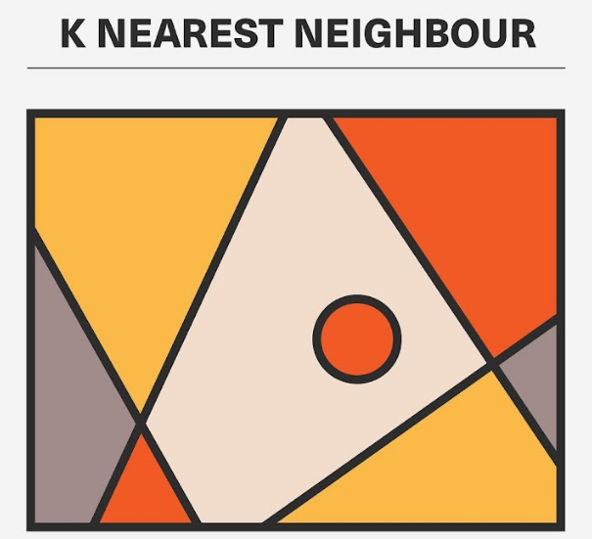
k-nearest neighbors algorithm is a non-parametric classification method, Finds intense application in pattern recognition, data mining and intrusion detection. Since it is non-parametric, it does not make any underlying assumptions about the distribution of data

Slide 27
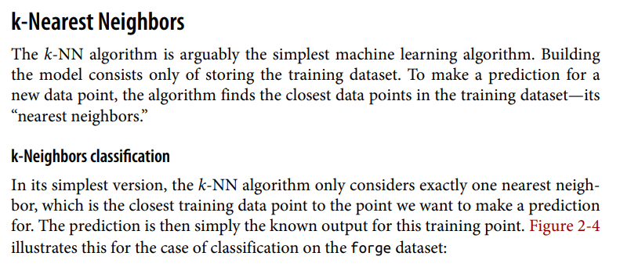

Slide 28
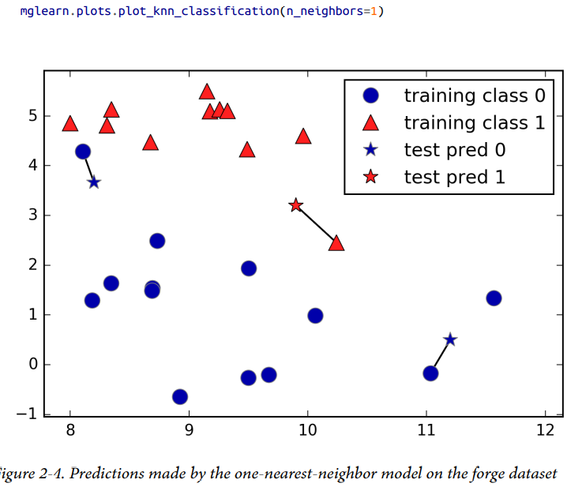
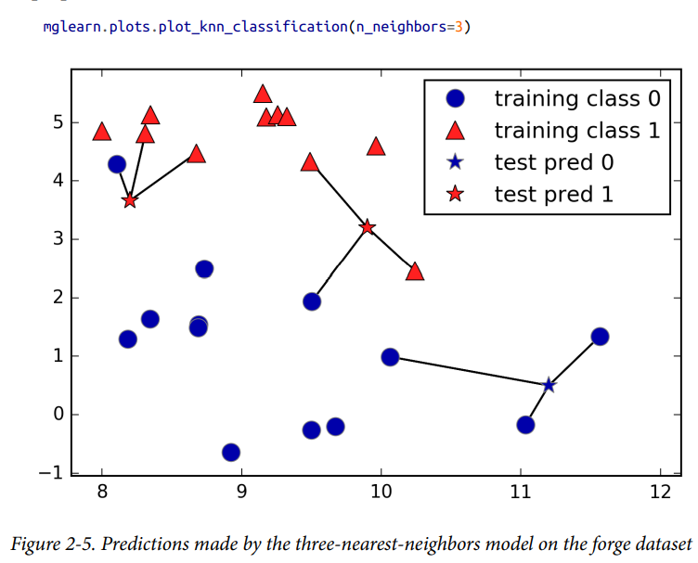

Slide 29
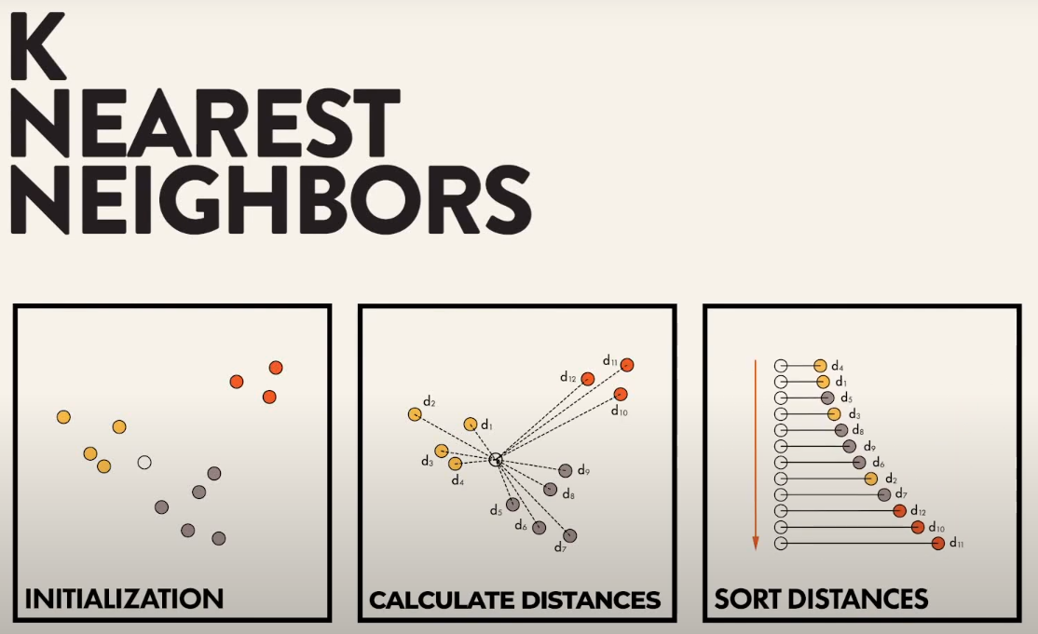

Slide 30
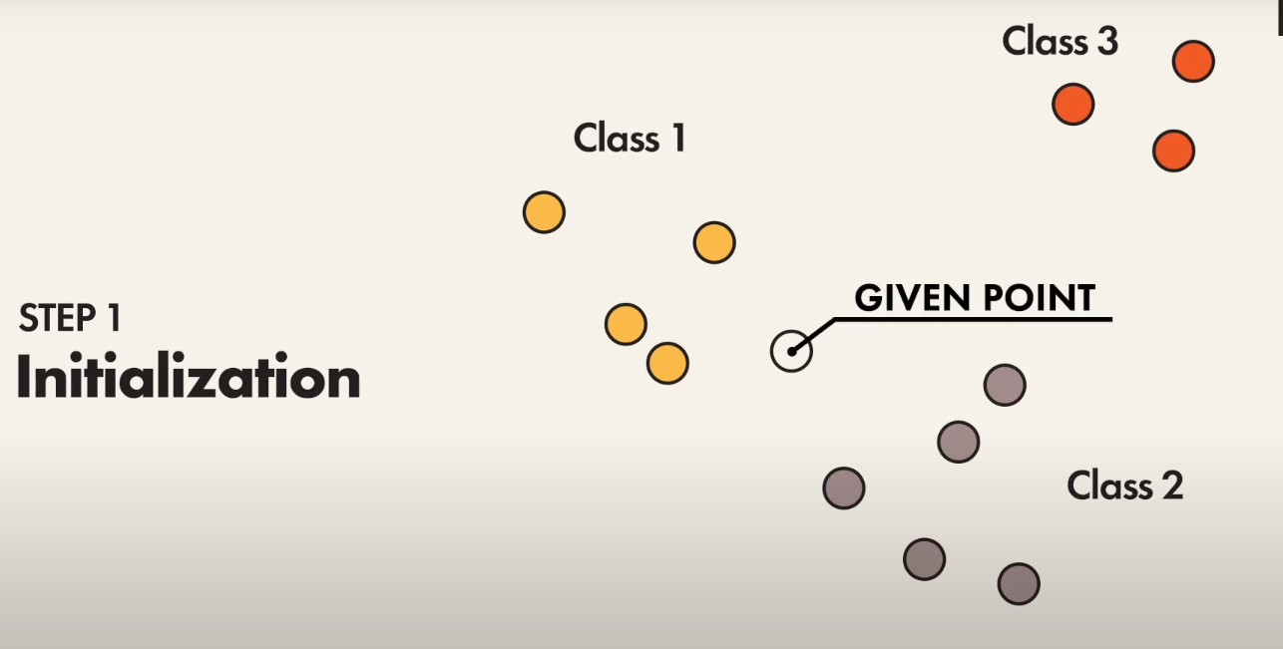

Slide 31
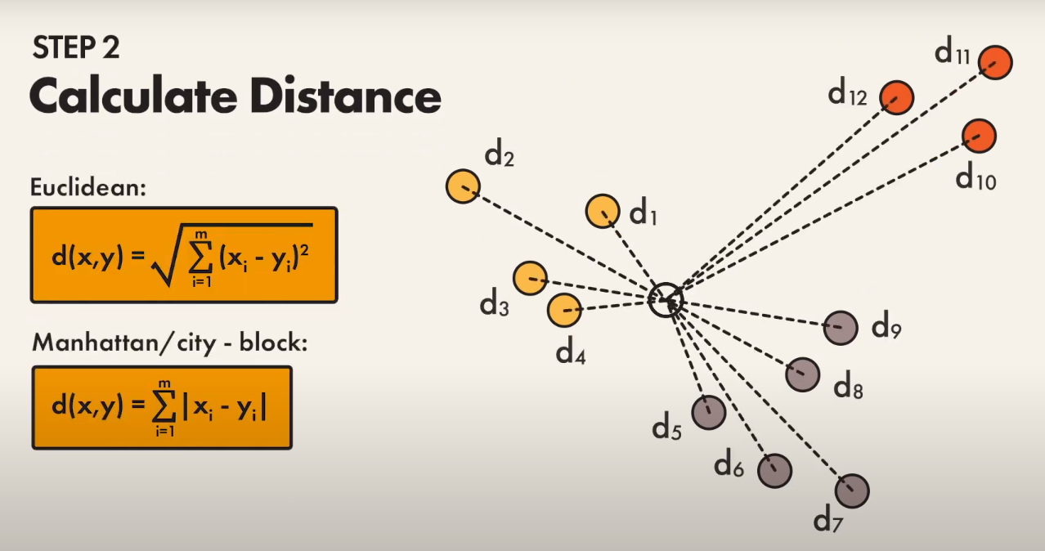

Slide 32
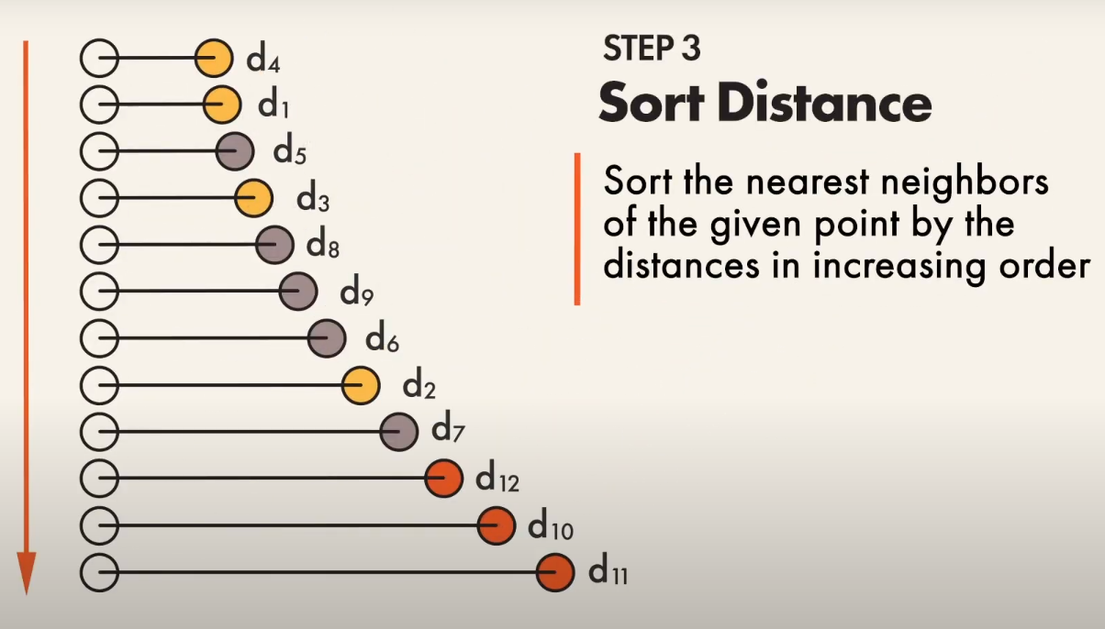

Slide 33
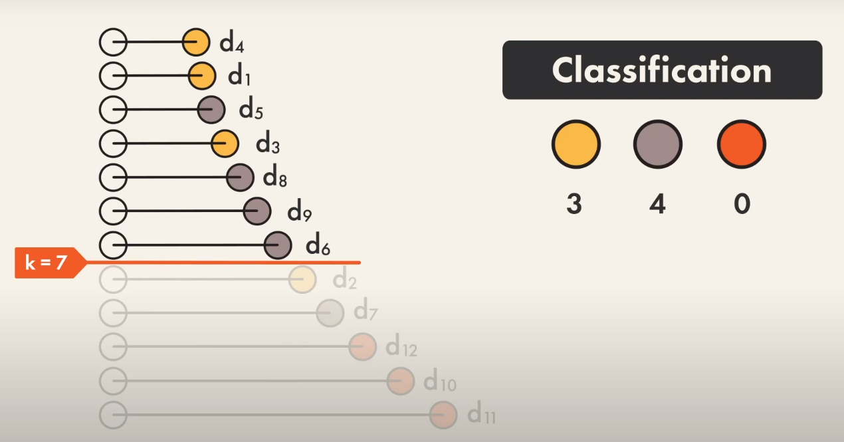

Slide 34
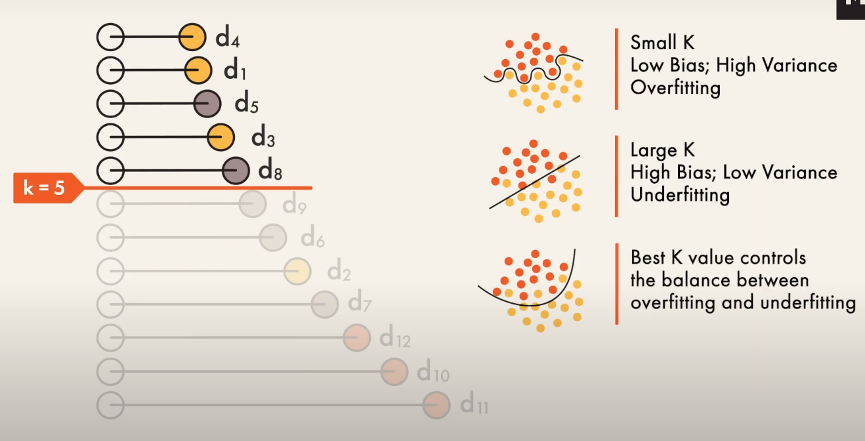

Slide 35
Algorithm | Best at | Pros | Cons
K-Nearest Neighbors | Computer vision | Fast, lazy training | Slow and cumbersome in the predicting phase
 | Multilabel tagging | Can naturally handle extreme multiclass problems (like tagging text) | Can fail to predict correctly due to the curse of dimensionality
 | Recommender systems
 | Spell checking problems

Slide 36
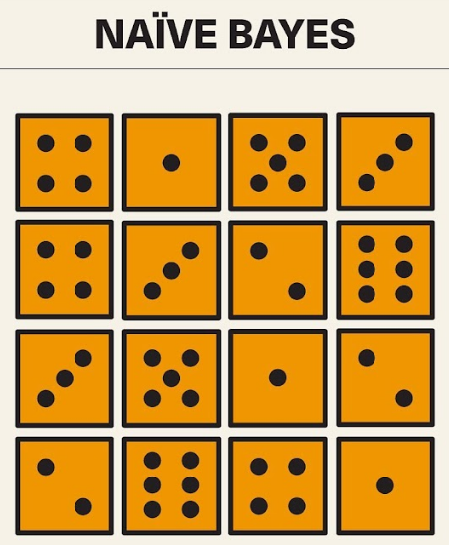
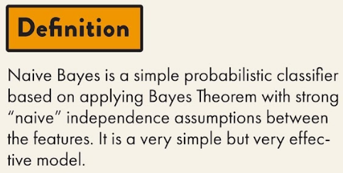




Slide 37


Slide 38



Decision trees are widely used models for classification and regression tasks

Slide 39



Slide 40


Random forests

Slide 41






Slide 42


Slide 43


Slide 44


Slide 45


Slide 46




Slide 47


Slide 48


Slide 49


Slide 50


Slide 51
Linear
Ridge
Lasso
Logistic
Regression
Bayesian
Naive Bayes
Dimensionality Reduction
Principal Component Analysis (PCA)
Instance Based
k-nearest Neighbour (kNN)
Machine Learning
Models
Decision Tree
Random Forest
Decision Tree
Clustering
Hierarchical Clustering
k-Means
Neural Networks

Slide 52


Slide 53

Machine Learning
Roadmap

Slide 54


Slide 55
NLP Roadmap waiting………….

Slide 56

NLP
Roadmap

